Slide 1




Slide 2


Submitted by:-
Submitted to:-
Md.Farmanul Haque Technical Trainer GLAU CSE Department
Piyush Singh(201500472) Ritik Kaushik(201500574) Vivek Kumar(201500805) Shivani Singh (201500660)
Smriti Gangwar (201500694)

Slide 3
Technologies used:-
Technologies that we have learnt so far are as follows:-
HTML
CSS
JavaScript
Bootstrap

Slide 4
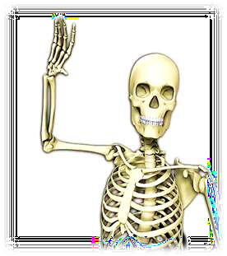
HTML
HTML is an acronym which stands for Hyper Text Markup Language which is used for creating web pages and web applications.
HTML describes the structure of a web page.
HTML consists of a series of elements.
HTML elements tell the browser how to display the content.
HTML elements label pieces of content such as “this is heading” , ”this is a
paragraph” , “this is a link” , etc.
A simple HTML Document:-
<!DOCTYPE html>
<html>
<head>
<title>WEB DEVELOPMENT</title>
</head>
<body>
<h1>Heading</h1>
<p>Paragraph</p>
</body>
</html>

Slide 5
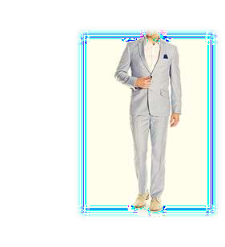
CSS
CSS stands for Cascading Style Sheets.
CSS describes how HTML elements are to be displayed on screen, paper, or in other
media.
CSS is used to define styles for our web pages, including the design, layout and variations in display for different devices and screen sizes.
The word cascading means that a style applied to a parent element will also apply to all the children elements within the parent. So if we set the color of the body text to “blue”, all headings , paragraphs and other text elements within the body will also get the same color(unless we specify something else).
CSS can be added to HTML document in 3 ways:-
INLINE:-by using the style attribute inside html elements.
INTERNAL:-by using a <style> element is <head> section.
EXTERNAL:-by using a <link> element to link to an External CSS file.

Slide 6
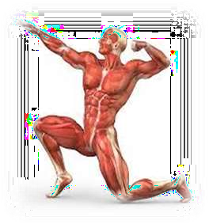
JavaScript
JavaScript is a programming language that is one of the core technologies of the
World Wide Web, alongside HTML & CSS.
JavaScript is used to create dynamic and interactive web content like
applications and browsers.
Some examples of JavaScript applications:-
Web And Mobile Apps
Game Development
Server Applications

Slide 7

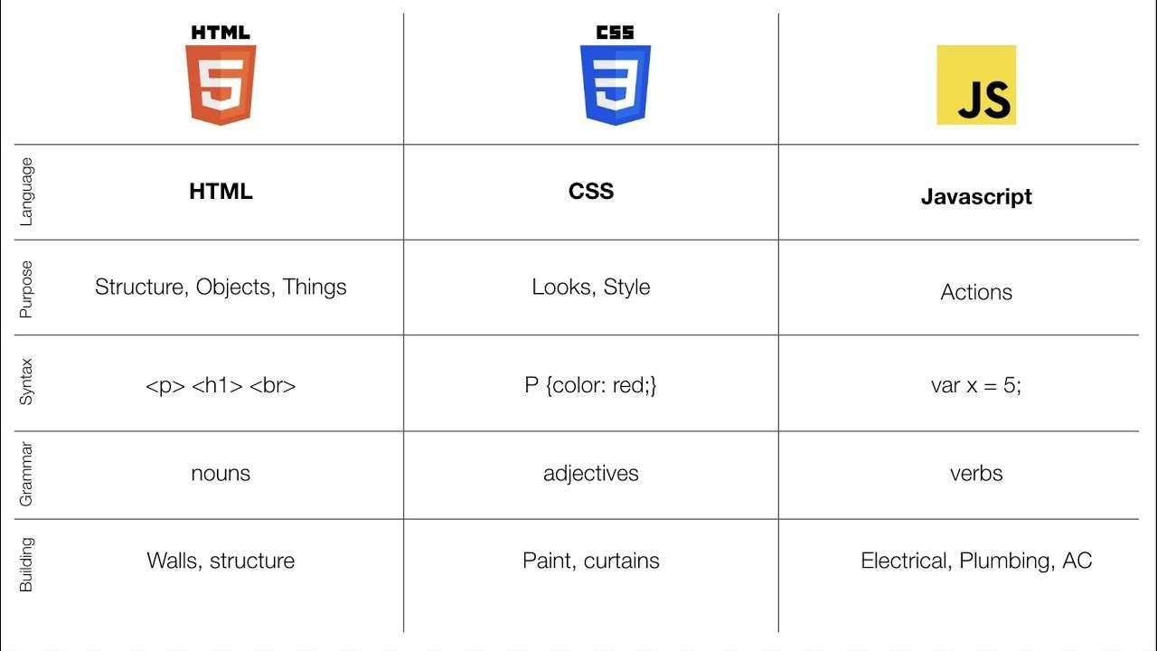
Difference-

Slide 8
Bootstrap
Bootstrap is a free front-end framework for faster and easier web development.
Bootstrap includes HTML and CSS based design templates for typography , forms , buttons , tables , navigation models , image carousels and may other, as well as optional JavaScript plugins.
Bootstrap also gives us the ability to easily creative responsive designs.
Responsive web design is about creating websites which automatically adjust
themselves to look good on all devices, from small phones to large desktop.
Advantages of Bootstrap:-
Easy to use
Responsive features
Mobile-first approach
Browsers Compatibility

Slide 9
Project Details:-
Project Name:-E-Commerce site
Language Used:- HTML,CSS,JS
User Interface Designs:-HTML ,CSS , Bootstrap
Web Browser:-Chrome
Tool Used:-VS Code
Server:-Localhost and Live server of VS Code

Slide 10
PROJECT IDEA
In today’s digital era, no matter what your area of business is, a strong online presence can be your most important selling point. And when the industry is all about visual appeal, an online presence becomes even more important to showcase your design style and get in new clients for new sports accessories.
Shopping is such a thing which has become very easy an accessible with the help of internet . This increase in ease in shopping has allowed many startups to flourish which now days are big MNC’S. Apart from big MNC’S such as flipkart and amazon there are many small scale startups as well which are emerging due their unique marketing ideas
.Our website spotify is such an attempt.

Slide 11
THE WEBSITE
The website includes all the trendy sports goodies, such as sports kit, comfortable shoes, all the sports equipment all at one place. Everything can be accessed with only one single tap.
This website is an attempt to deliver all the goods one must have to be a game changer.
This website is developed using HTML, CSS, and JavaScript.

Slide 12
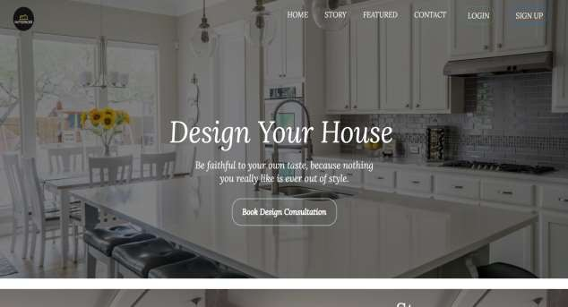
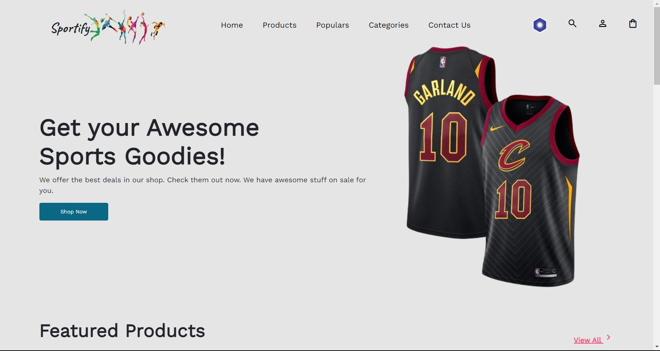
HOME PAGE
▶ The first impression is the last. This line should be the foundation of your homepage. Home page is the first thing customers see when they land on your website, and you don’t want to go wrong with that. This is the place to capture their attention, and they decide if they wish to delve into the other pages.
▶ A homepage should be rife with details yet simple. Color schemes, images, font, tone—every element affects the
customer’s subconscious thinking. The page should be clutter-free, inviting, and pleasing to the eyes.

Slide 13
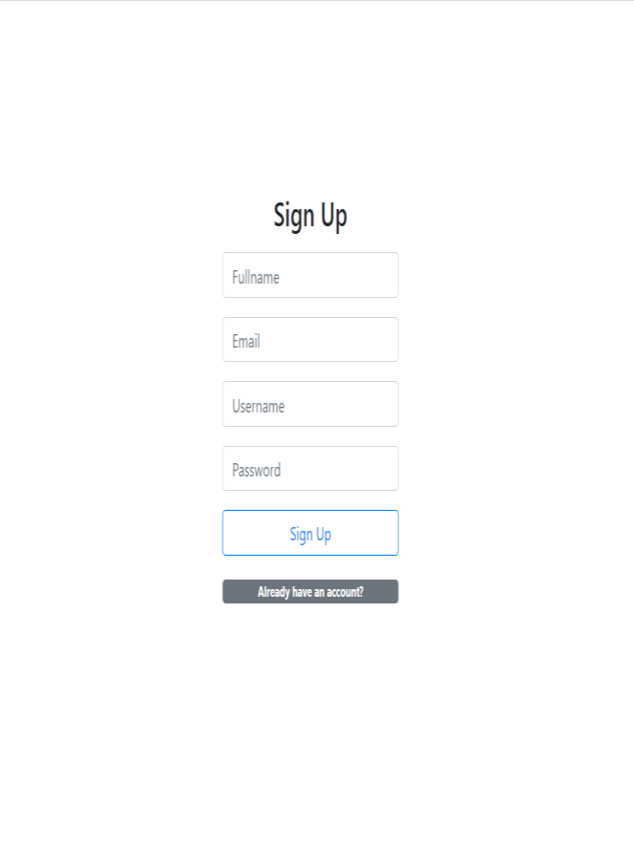
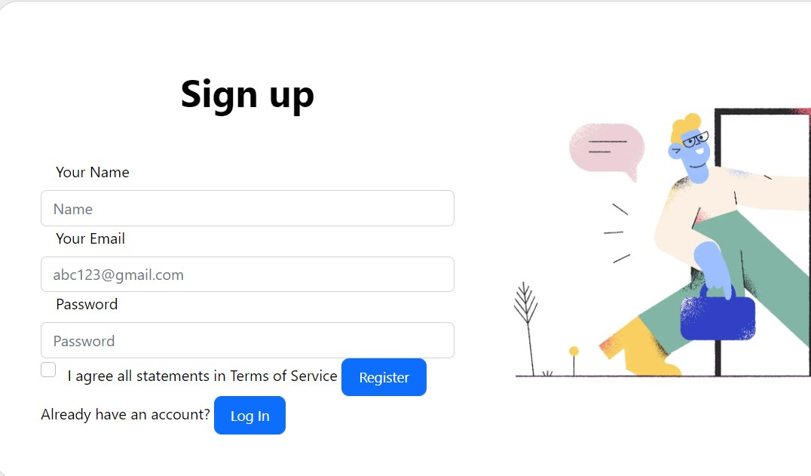
SIGN-UP PAGE
▶ The sign-up page has features like full name, email , username, password.
▶ The user can create an account by giving their full name, email id , username, password.
▶ Once the Signup button is clicked, the user credentials will get stored.

Slide 14
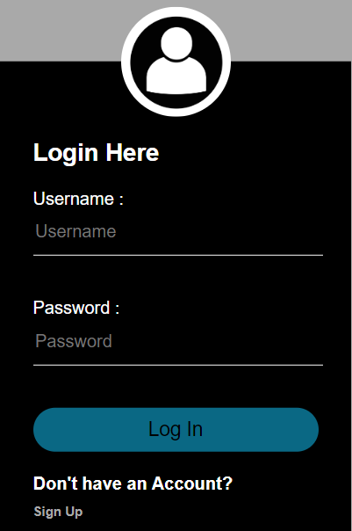
LOGIN PAGE
LOGIN PAGE
▶ In this page, the user can login to the website using their respective username and password.
▶ On clicking the login, the application will authenticate the user with the credentials stored.

Slide 15
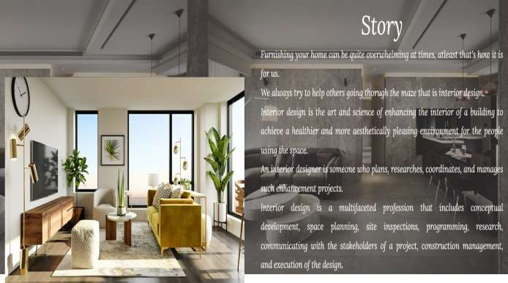
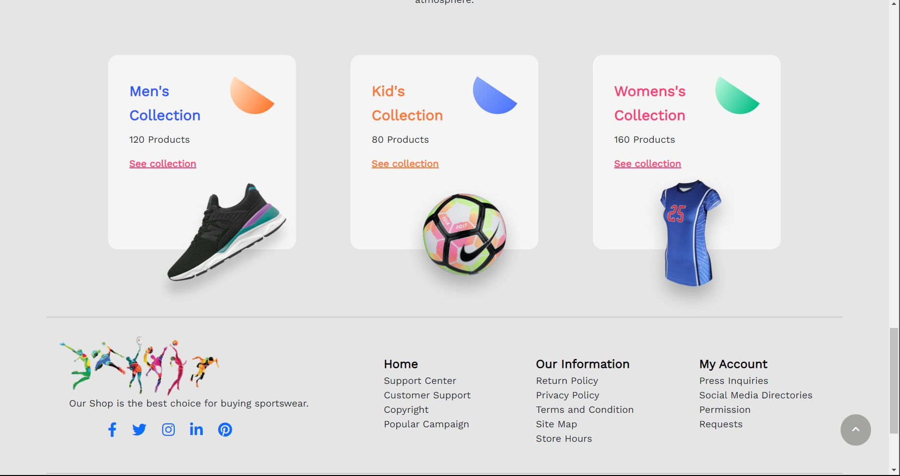
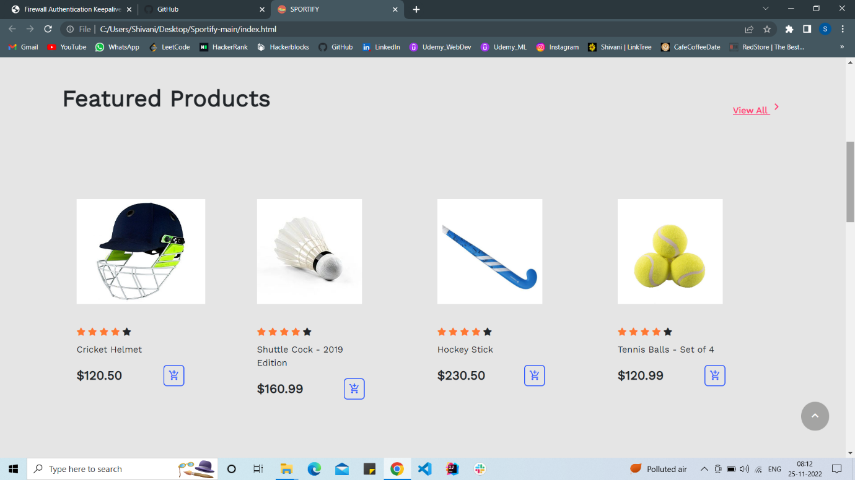
Features:-
▶ our website is loaded with a lot features and variour social links, you want the world to know about your website. It helps the customer know who they are working with and contributes to a personalized connection.
▶ we have different section for men, women and kids .
we got a popular section at the top which help you to go with the trend

Slide 16
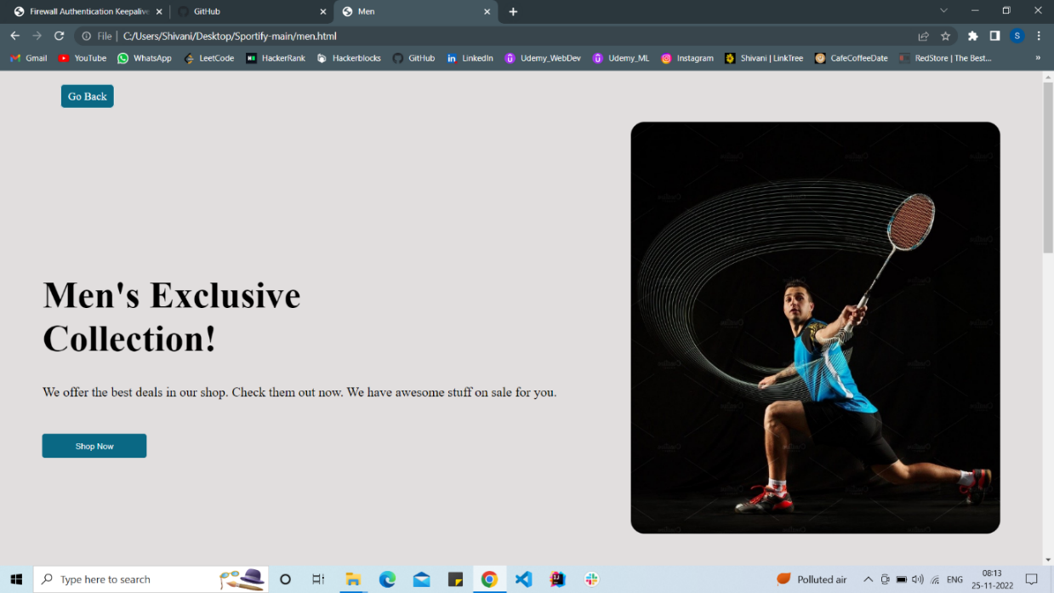
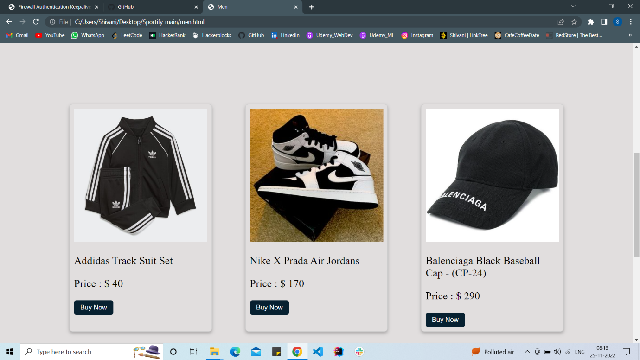
This page showcases the different range of categories that we provide like men , kids and women collection. The user can select the category upon their interest and we provide the products that we showcase, The user have plenty of options to look stylish while playing sports which will give them a confidence boost which we all need in today’s era. Men’s Collection:
C

Slide 17
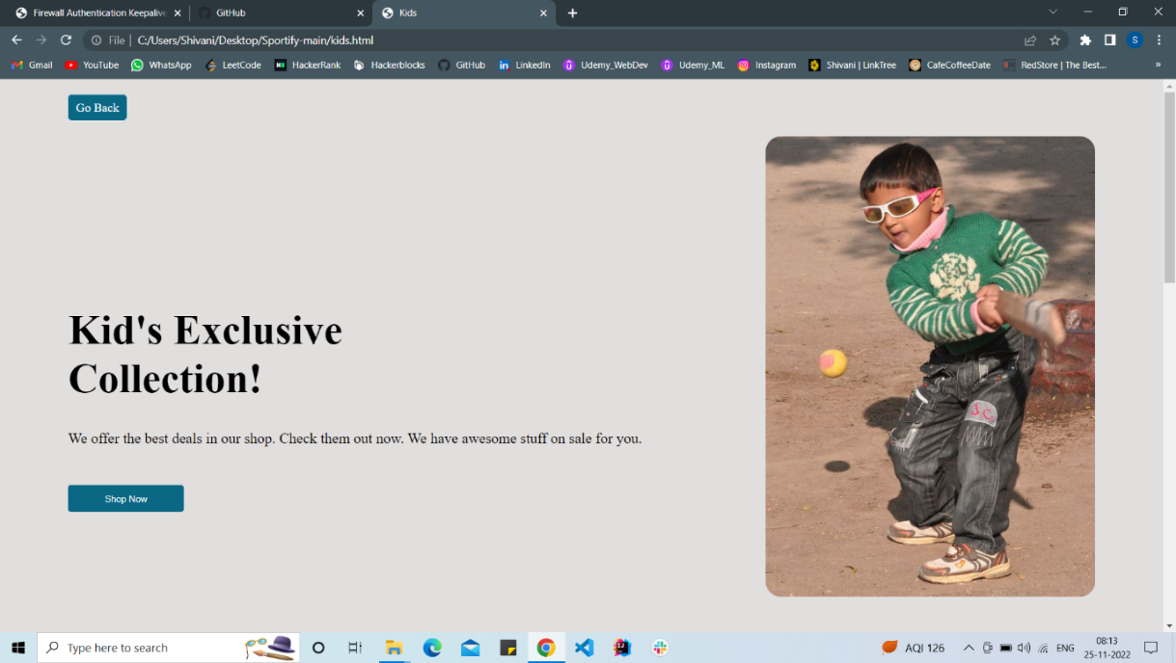
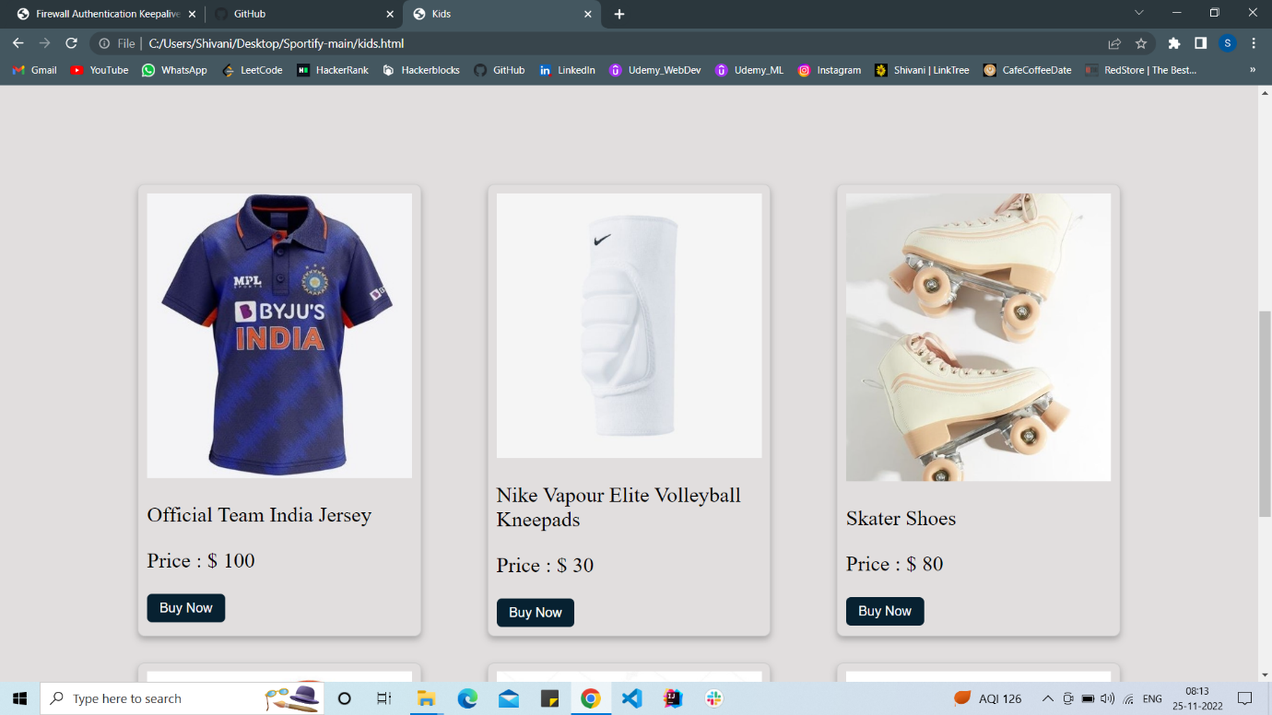
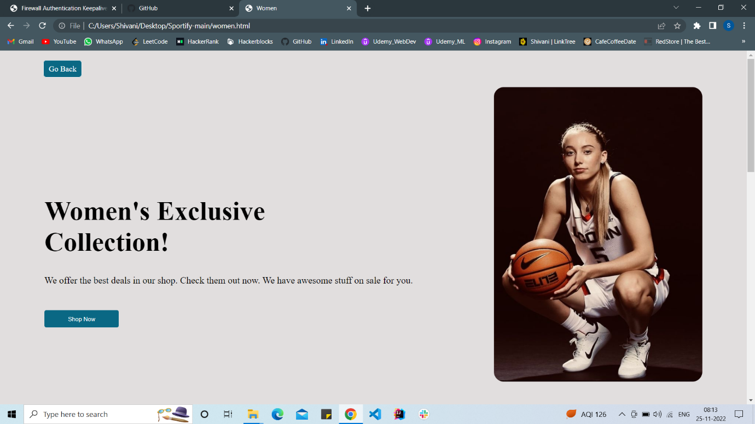
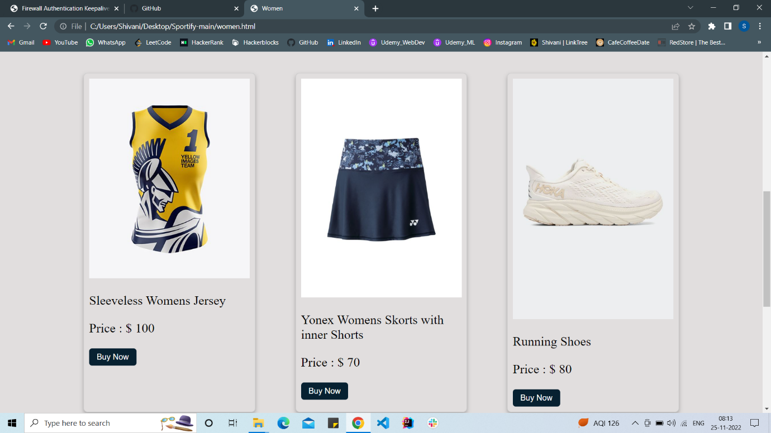
Women’s Collection:
Kid’s Collection :

Slide 18
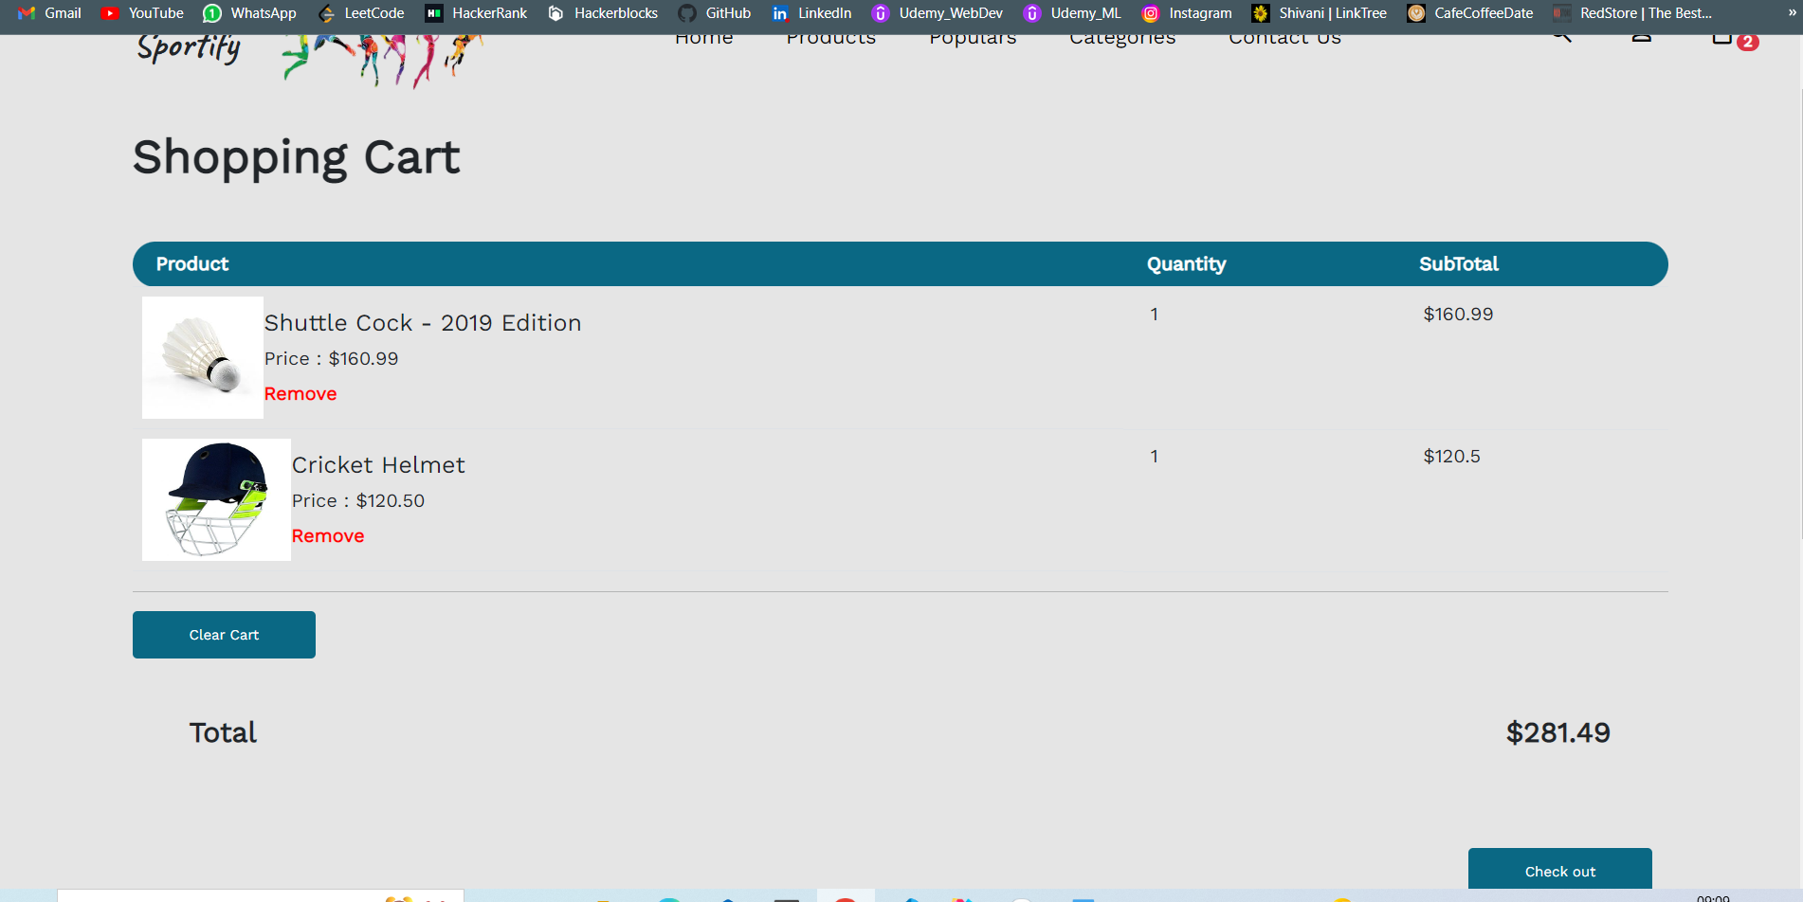
The shopping cart is added so that user can add their products that they want to buy in single click. The shopping cart has features to add or remove the item from the cart or to clear the cart. A message is displayed when we add any item to the cart. A successful transaction from the cart displays a check sign indicating that the order has been placed successfully.
Shopping Cart:

Slide 19
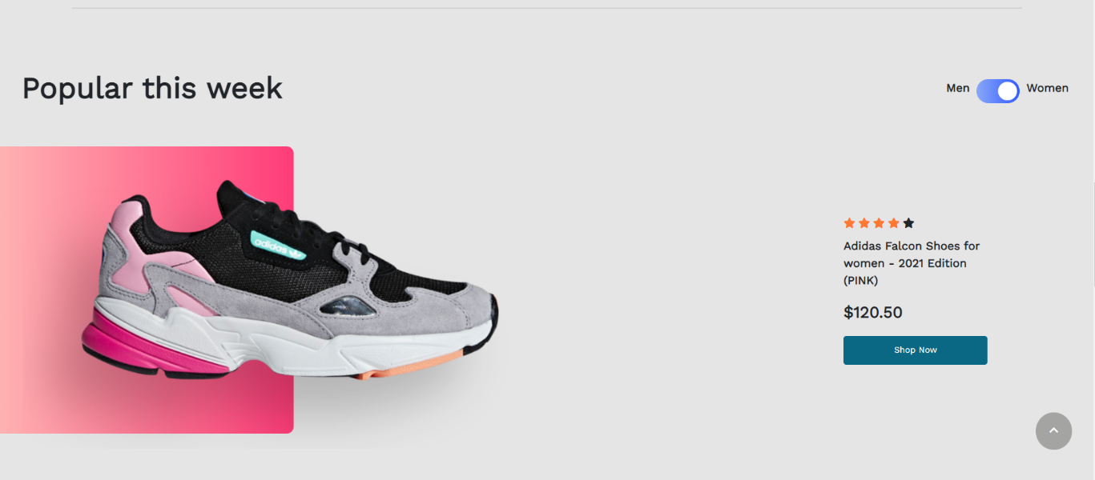
This page showcases the product that have been in demand in past week. The user will know the trendiest style by looking at this page which will gain their interest and they can order the product with just single tap.
Features

Slide 20
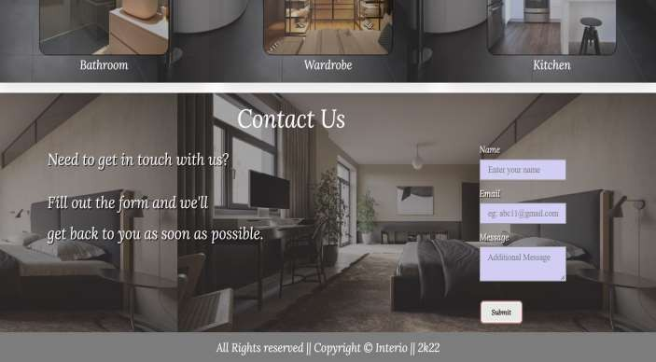
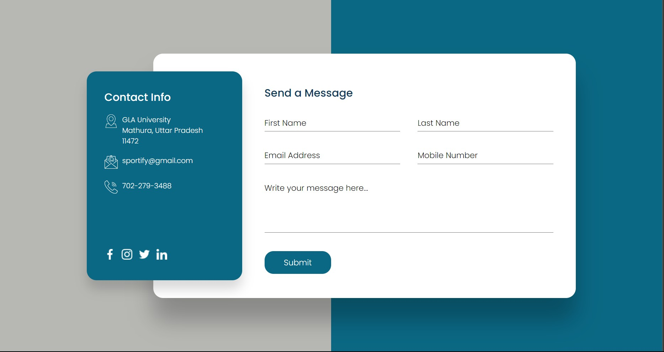
CONTACT PAGE
▶ The user can contact the author of the website using this contact form.
▶ The user can enter his Name, email address along with the body of message.
▶ After entering the data in the contact form, when the user click the submit button, the email will be sent to the author.

Slide 21
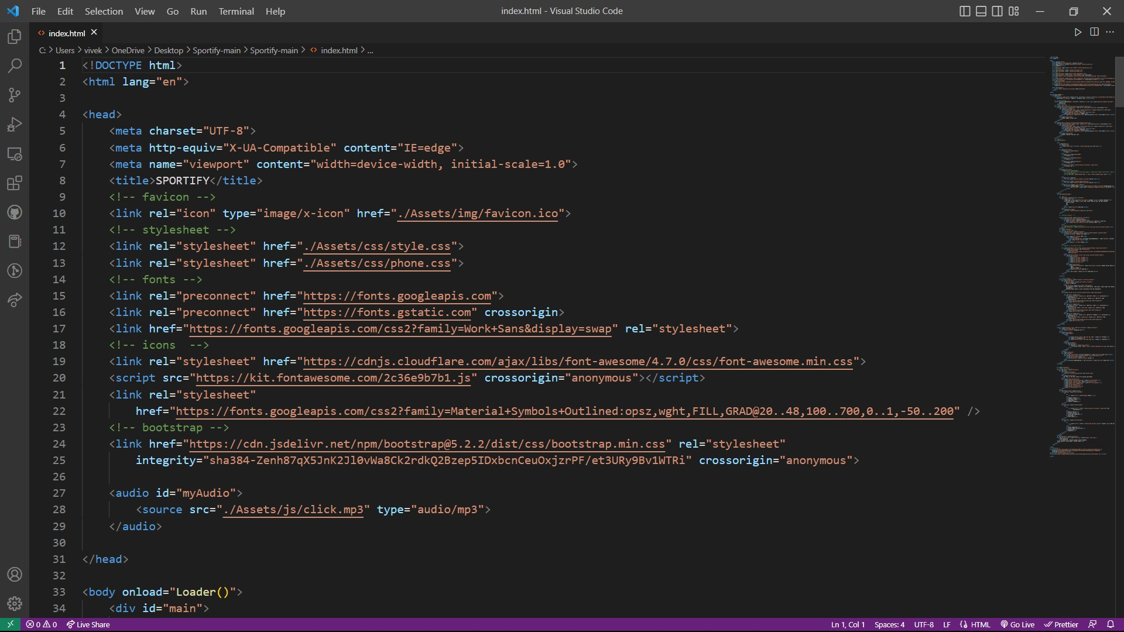
code :-

Slide 22
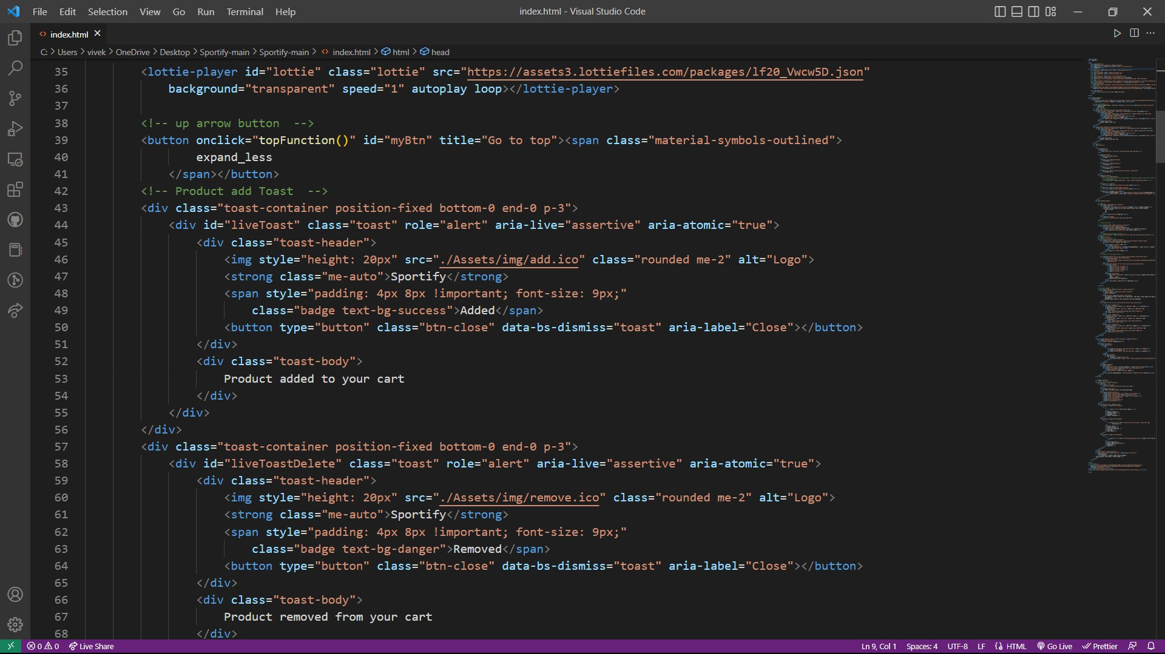
code cont :-

Slide 23
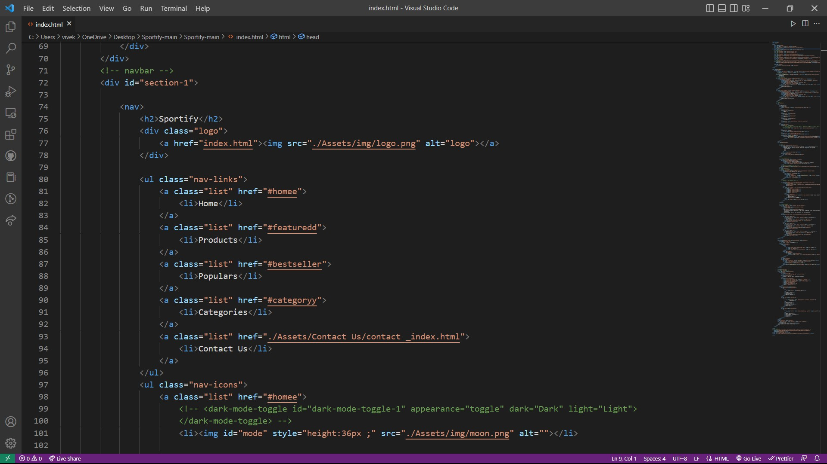
code cont :-

Slide 24
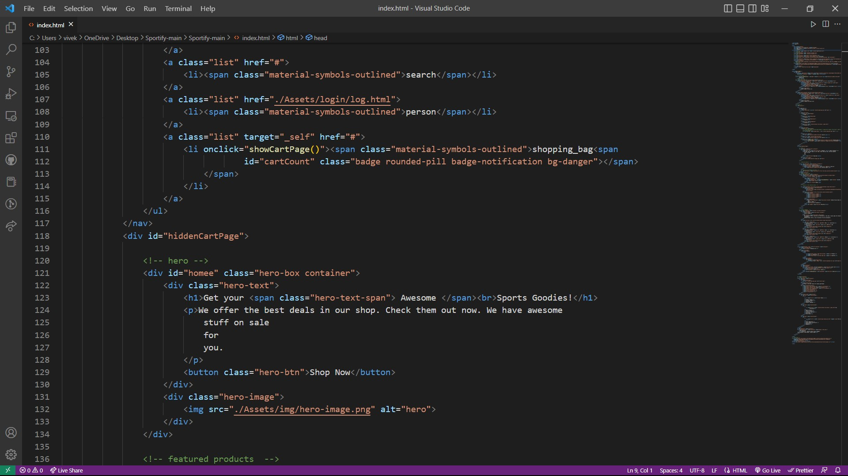
code cont:-

Slide 25
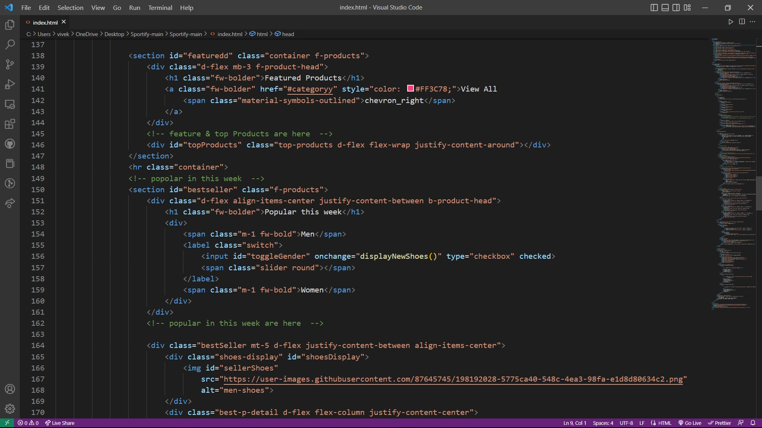

Slide 26
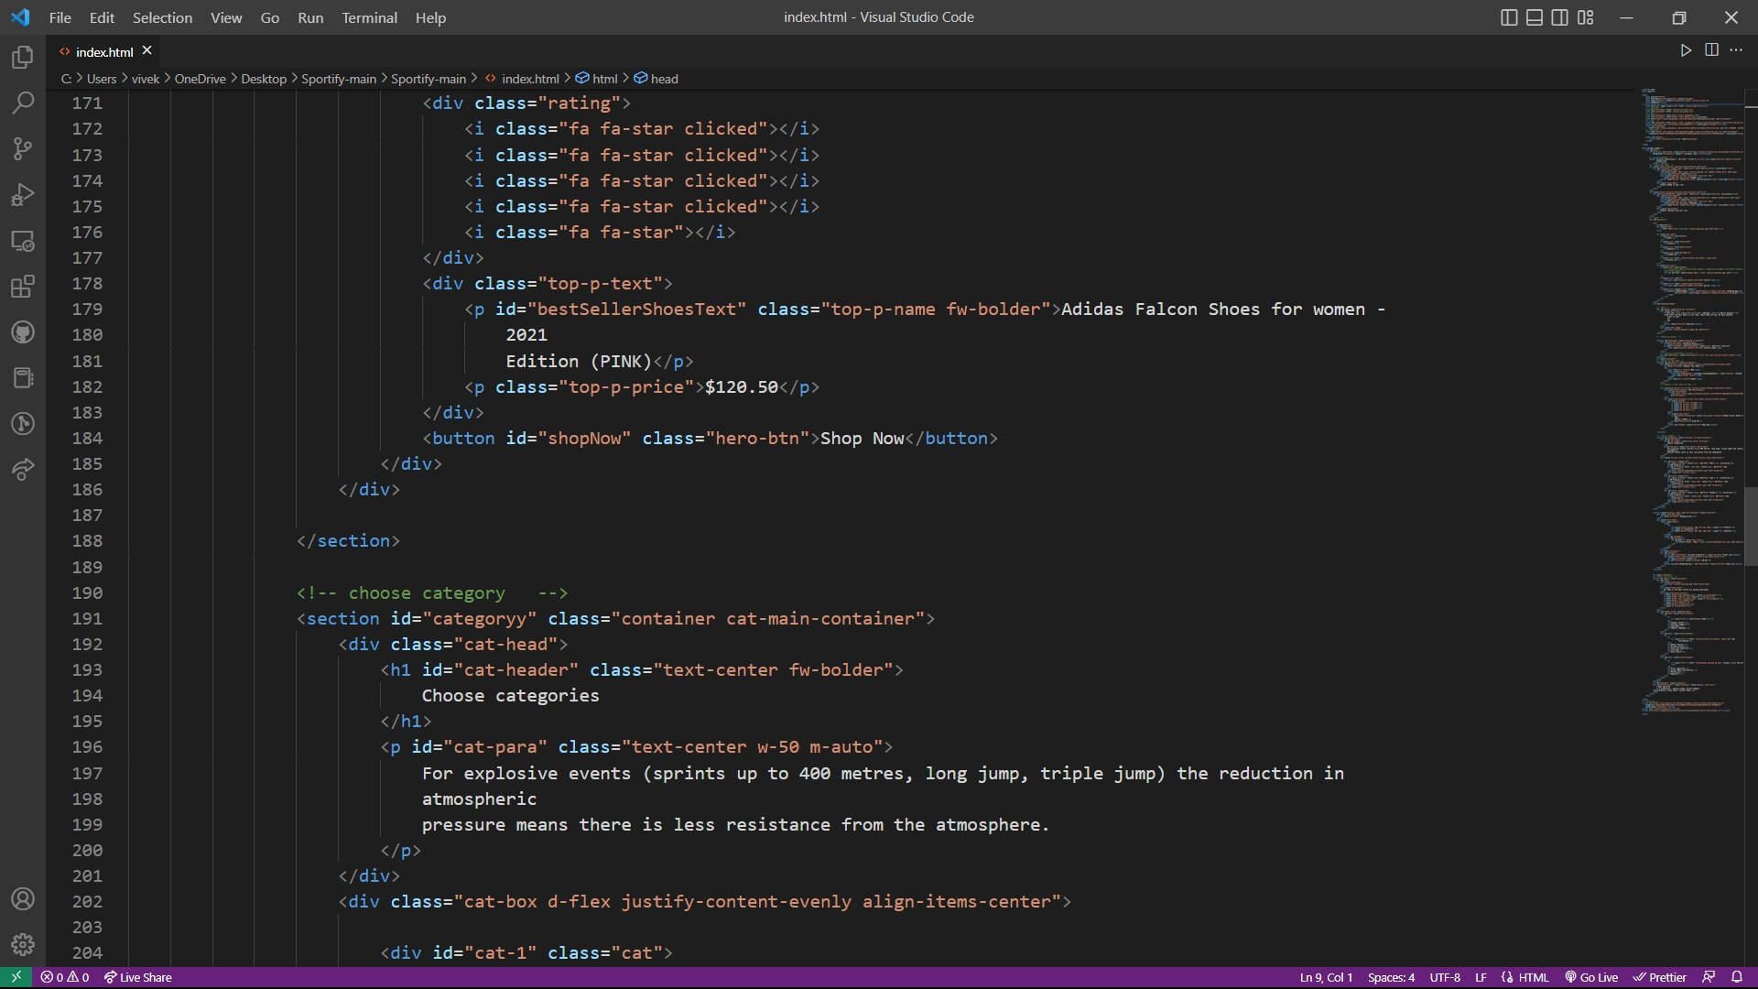

Slide 27
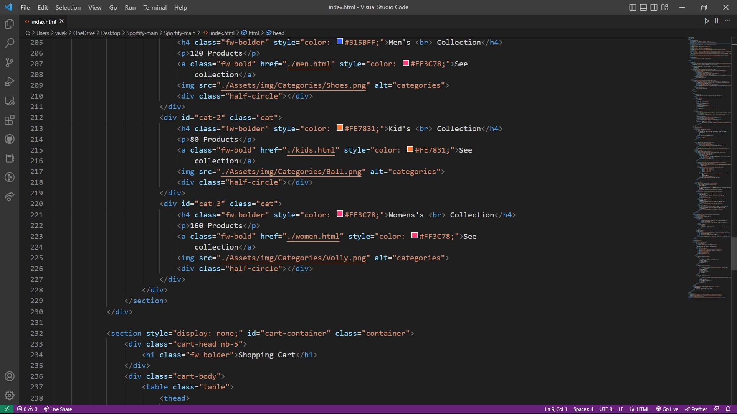

Slide 28
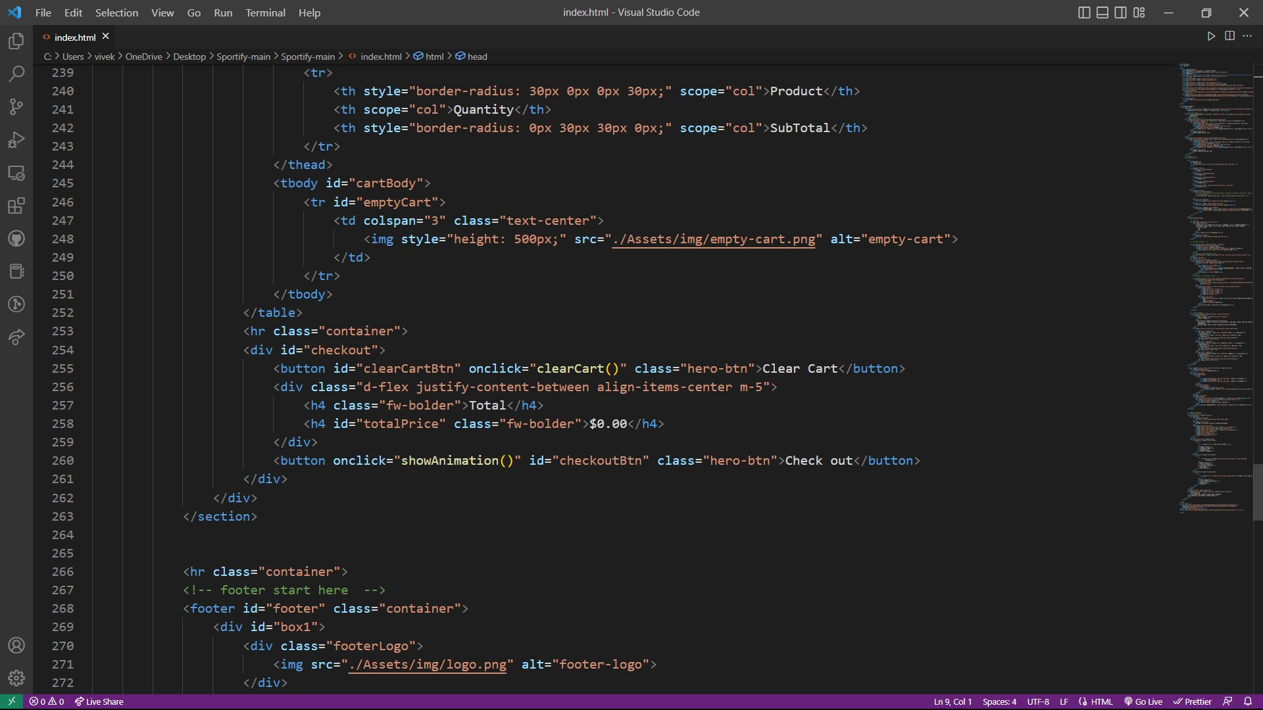

Slide 29
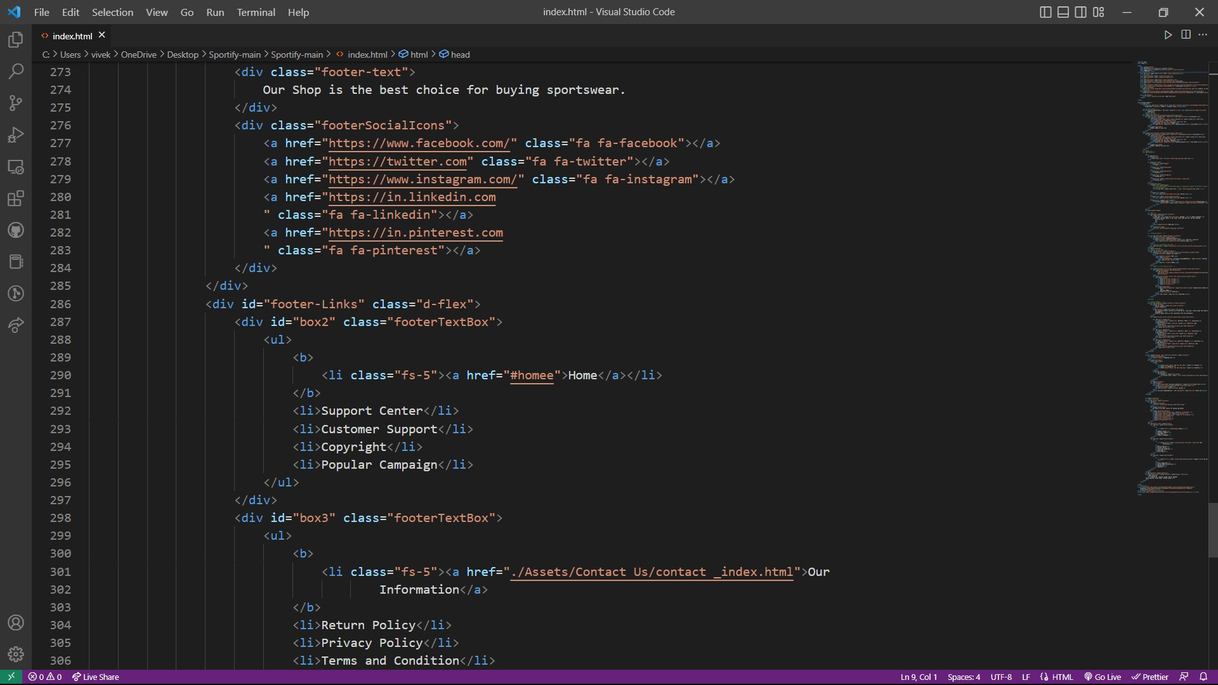

Slide 30
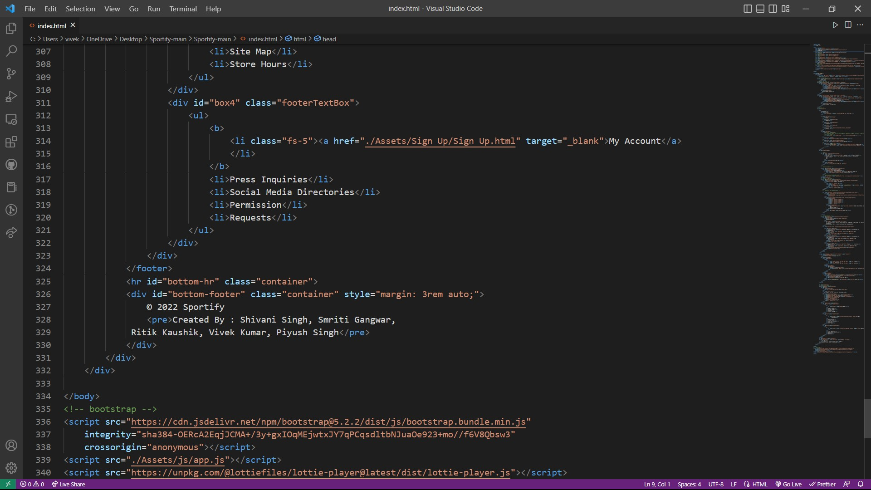

Slide 31
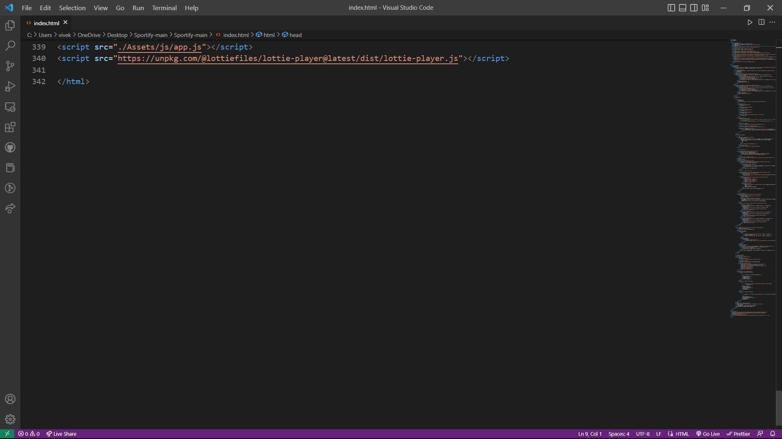

Slide 32


THANKYOU

